Slide 1

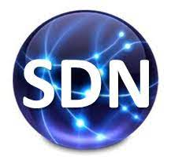
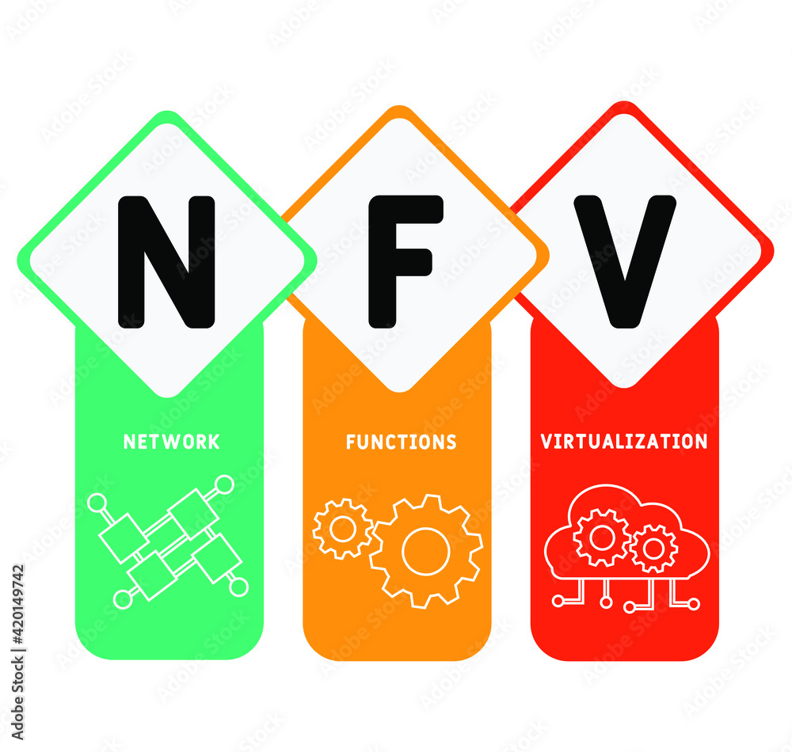

PDS
Computer Vision
Application
Podman Simulation
Grafana
grafana-diagram
Mqtt-
Flow-Diagram
Visualization
https://github.com/siagianp
https://www.youtube.com/@AmelOline/videos
https://github.com/amelcharolinesgn2/IoT_simulator-mqtt-NodeRed
https://github.com/amelcharolinesgn2/Cloud-Infrastructures
https://github.com/amelcharolinesgn2/ClouD-Infrastructure-SISKA-2025
Notes:
https://medium.com/buildpiper/simplifying-containerization-with-docker-run-command-2f74e114f42a
https://github.com/IBA-Group-IT/IoT-data-simulator
https://www.bevywise.com/blog/docker-mqtt-broker-easy-service-manageability/

Slide 2

Project ???? >>>
Summary : Paper reference and Run a Github
Title Paper : IoT Enhanced Deep Water Culture Hydroponic System for Optimizing Chinese Celery Yield and Economic Evaluation
Link :
Github : IoT Enhanced Deep Water Culture Hydroponic System for Optimizing Chinese Celery Yield and Economic Evaluation
Link :
Langkah Langkah Menjalankan
Dari judul tersebut. Uraikan Rumusan masalah, tujuan, Langkah-langkah yang dilakukan, Tahapan penelitian, Analisa hasil penelitian, research Gab, Relefansi teori yang digunakan, Github nya
Docx
Docx/pptx
Summary
What a News Gap ?
What are you purposed ?
You have Changes a Flow Process and Diagram ?
What are you purposed ?
Submit your Project on GD link
Title Paper_ Old :>> IoT Enhanced Deep Water Culture Hydroponic. Docx
IoT.Zip Old : >> Application and Step by step How to Run
Title Paper_ News :>> IoT Enhanced Deep Water Culture Hydroponic. docx
IoT.Zip a News : >> Application and Step by step How to Run
Persentation :>> IoT Enhanced Deep Water Culture Hydroponic.PPTX

Slide 3
Ex0: >>
IoT Enhanced Deep Water Culture Hydroponic System for Optimizing Chinese Celery Yield and Economic Evaluation
Latarbelakang:
Kebutuhan untuk meningkatkan hasil panen Chinese celery secara efisien.Ketergantungan pada kondisi lingkungan (suhu, cahaya) yang fluktuatif.Minimnya penerapan IoT dalam sistem hidroponik untuk tanaman ini secara spesifik.Rumusan masalah:Bagaimana sistem hidroponik DWC yang didukung oleh kontrol suhu dan pencahayaan berbasis IoT dapat meningkatkan hasil panen dan efisiensi ekonomi dalam budidaya Chinese celery?
Langkah-langkah Penelitian:
Desain sistem kontrol berbasis mikrokontroler ESP32 dan sensor suhu, kelembapan, pH, dan EC.
Desain empat kondisi perlakuan:
Kontrol suhu + cahaya
Hanya kontrol suhu
Hanya kontrol cahaya
Tanpa kontrol (alami)
Instalasi dalam 4 greenhouse DWC.
Penanaman Chinese celery selama 45 hari.
Monitoring otomatis melalui platform IoT (Blynk).
Analisis hasil pertumbuhan dan performa ekonomi.
Tahapan Penelitian:
Perencanaan sistem: Identifikasi kebutuhan sensor, aktuator, dan mikrokontroler.
Implementasi perangkat keras dan lunak: Integrasi sensor EC, pH, DHT (temperature & humidity), kontrol LED, pompa air, dan sistem misting.
Instalasi di lapangan: 4 greenhouse dengan perlakuan berbeda.
Pengumpulan data: Berat tanaman, tinggi tanaman, suhu, kelembapan, pencahayaan, setiap 5–7 hari.
Analisis data: Uji statistik (uji Friedman).
Evaluasi ekonomi: ROI, net profit, payback period.
Tujuan:
Menerapkan sistem kontrol suhu dan cahaya otomatis berbasis IoT dalam metode hidroponik DWC.Menganalisis pengaruh kombinasi kontrol tersebut terhadap pertumbuhan Chinese celery.Melakukan evaluasi ekonomi terhadap sistem IoT-enhanced dibandingkan sistem konvensional.

Slide 4
Ex0: >>
IoT Enhanced Deep Water Culture Hydroponic System for Optimizing Chinese Celery Yield and Economic Evaluation
Analisa Hasil:
Perlakuan kombinasi kontrol suhu dan cahaya menghasilkan hasil tertinggi (30,3 kg), dibandingkan kontrol alami (26,6 kg).
Kontrol suhu lebih signifikan terhadap pertumbuhan dibandingkan pencahayaan.
ROI terbaik justru pada sistem sederhana (tanpa kontrol), karena biaya awal lebih rendah, meskipun hasilnya sedikit lebih kecil.
Sistem IoT cocok untuk jangka panjang dan skala komersial.
Peningkatan efisiensi hingga 13,9% dari segi hasil panen.
Research Gap:
Penelitian sebelumnya banyak fokus pada tanaman lain, atau hanya satu variabel lingkungan (misalnya hanya suhu atau hanya cahaya).
Belum banyak kajian yang:
Mengombinasikan kontrol suhu + cahaya secara simultan.
Menerapkan analisis ekonomi secara mendalam.
Menggunakan sistem DWC (Deep Water Culture) yang dikontrol secara penuh dengan IoT untuk tanaman Chinese celery.
Github :
ESP32Sensor pH, EC, DHTSoftware kontrol via BlynkKode berbasis Arduino IDE
Referensi GitHub / kode
Hydruino (GitHub: NachtRaveVL/Simple‑Hydroponics‑Arduino) — controller hidroponik DIY berbasis Arduino/ESP32 yang mendukung sensor pH & EC. GitHub
SOIL_INTEGRATED_Sensor_NPK‑PH‑MOISTURE‑EC_InterfaceESP32 (GitHub: VinhCao09) — kode untuk sensor gabungan NPK, pH, EC, kelembapan berbasis ESP32. GitHub
PlantMonitoringSystem (GitHub: Shishir3D) — proyek monitoring tanaman dengan ESP32 + Blynk, walaupun fokus utama soil/kelembapan, bisa dikembangkan ke hidroponik. GitHub
Artikel “Design of a smart hydroponics monitoring system using ESP32 and the Internet of Things” — memberikan desain dan data nyata untuk sistem hidroponik yang termonitor pH, EC, suhu. PMC
Skripsi “Rancang Bangun Sistem Kontrol Nutrisi Tanaman Hidroponik Berbasis IoT Dengan Blynk” — cocok sebagai acuan implementasi aplikasi Android + ESP32 + sensor pH/TDS. UMS ETD-db
Rekomendasi langkah adaptasiPilih board ESP32 (misalnya ESP32‑DevKit) sebagai mikrokontroler utama.Integrasikan sensor:pH probe (air larutan hidroponik)EC/TDS sensor (untuk mengukur konsentrasi nutrisi)Suhu & kelembapan udara (DHT22 atau sensor alternatif)Suhu air (misalnya DS18B20)Sensor cahaya (optional, buat kontrol LED atau pencahayaan)Koneksi ke internet via WiFi; gunakan Blynk untuk antarmuka mobile: menampilkan data real‑time, menerima kontrol (misalnya pompa nutrisi, LED grow, pengudaraan).Scripting: baca sensor secara berkala, kirim ke Blynk; jika kondisi melewati threshold → aktifkan aktuator (pompa pengatur pH, pompa nutrisi, fan, lampu).Kalibrasi sensor pH/EC dan buat log historis untuk analisis.Simpan data (opsional) ke cloud atau server lokal untuk dataset dan analisis lebih lanjut.Dokumentasi kode di GitHub sendiri: README, wiring diagram, kode, library yang dipakai, petunjuk instalasi.

Slide 5
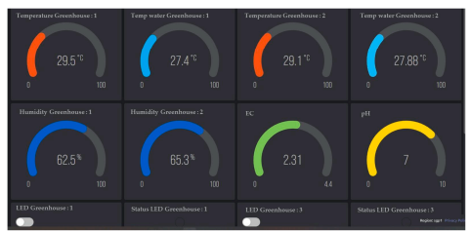
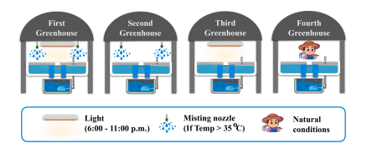
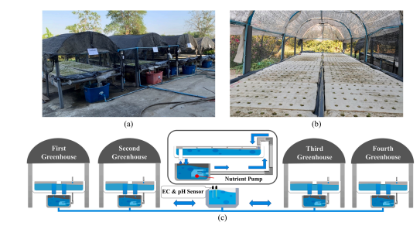
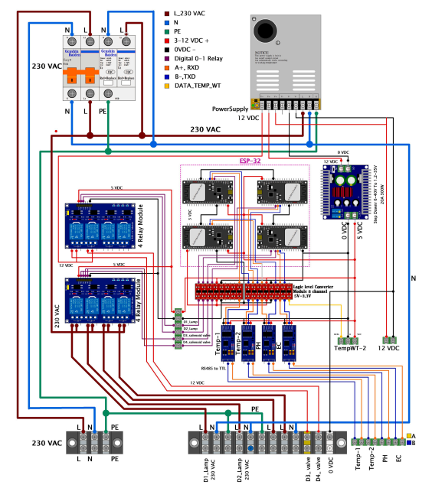
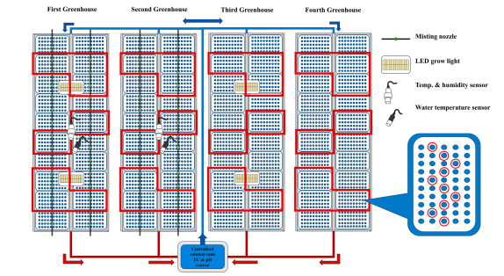
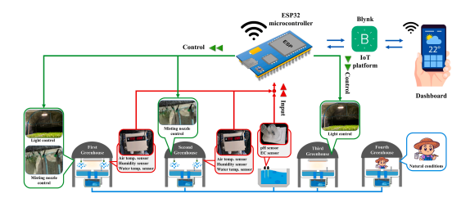
Ex0: >>
IoT Enhanced Deep Water Culture Hydroponic System for Optimizing Chinese Celery Yield and Economic Evaluation
3. Materials and methods
3.1. Hydroponic system components and IoT equipment
Fig. 3. Blynk IoT dashboard for data display and system management
Fig. 6. Experimental setup of four greenhouses with varied environmental controls to study celery growth.
Fig. 1. Greenhouse structure and hydroponic system for Chinese celery cultivation: (a) Open-structure greenhouse (b) Foam tray planting system (c) Schematic of
water circulation system and inter-greenhouse connections.
Fig. 2. ESP32-based greenhouse control system using the Blynk IoT platform
Fig. 4. ESP32-based control circuit diagram.
Fig. 7. Celery sampling layout.

Slide 6
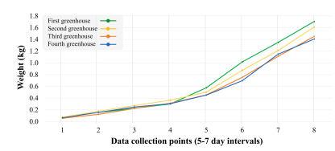

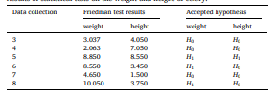
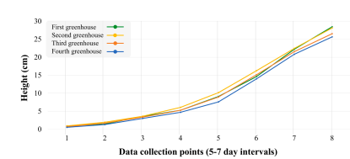
Ex0: >>
IoT Enhanced Deep Water Culture Hydroponic System for Optimizing Chinese Celery Yield and Economic Evaluation
Table 3 Comparative celery growth relative to natural conditions
Table 2 Results of statistical tests on the weight and height of celery
Fig. 8. Celery weight changes across four greenhouses over 40-45 day cultivation period
5. Conclusions
This study demonstrates significant progress in integrating IoT
technology with hydroponic farming systems, particularly for Chinese celery production. The findings reveal that environmental control using technology can significantly enhance both crop quality and quantity, with the greenhouse managing both temperature and extended light duration showing a 13.91% increase in yield compared to natural conditions
Fig. 9. Celery height progression in different greenhouse conditions during 40-45 days growth cycle.

Slide 7
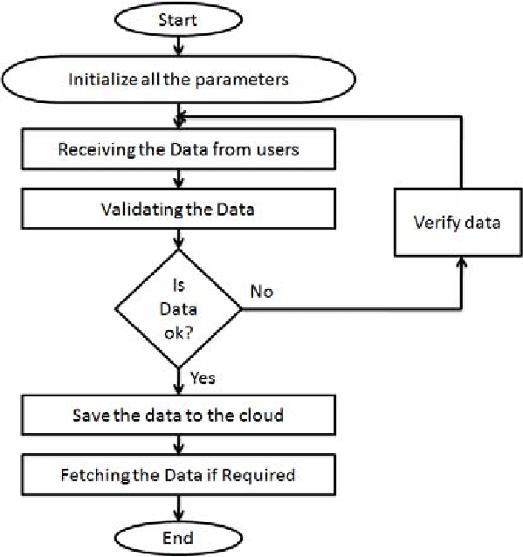
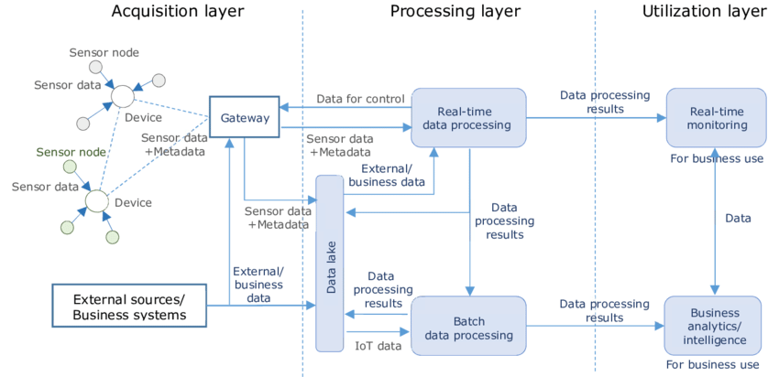
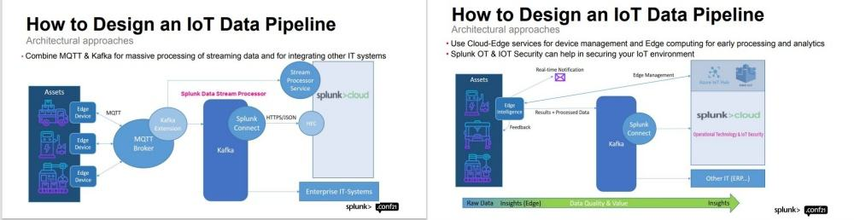
Ex0: >>
github simulation podman based IoT data sensor flow diagram, visualisasi
Referensi :
PlantMonitoringSystem (GitHub: Shishir3D/PlantMonitoringSystem) — sistem monitoring tanaman berbasis ESP32 + sensor + Blynk. GitHub
Water‑Monitoring‐System (GitHub: vinitshahdeo/Water‑Monitoring‑System) — IoT monitoring level cairan + dashboard. GitHub
Smart‑Irrigation‑System‑Using‑IoT (GitHub: polarao/Smart‑Irrigation‑System‑Using‑IOT‑Based‑On‑Temperature‑And‑Moisture‑In‑Soil) — sistem sederhana sensor kelembapan dan suhu untuk irigasi otomatis. GitHub
A. Automation System
Deskripsi:Sensor (pH, EC, suhu, kelembapan) mengumpulkan data di lapanganMikrokontroler (misalnya ESP32) mengirimkan data via WiFi/MQTT/HTTP ke broker atau serverBroker/message queue (MQTT, Kafka) menerima dan menyalurkan dataBackend penyimpanan (time‑series DB seperti InfluxDB, relasional, atau data lake)Visualisasi/dashboard (Grafana, ThingsBoard, web UI)(Opsional) Aktuator: berdasarkan data, trigger pump, lampu, kipas

Slide 8
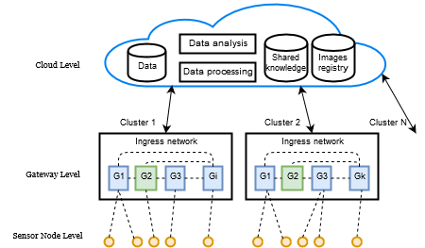
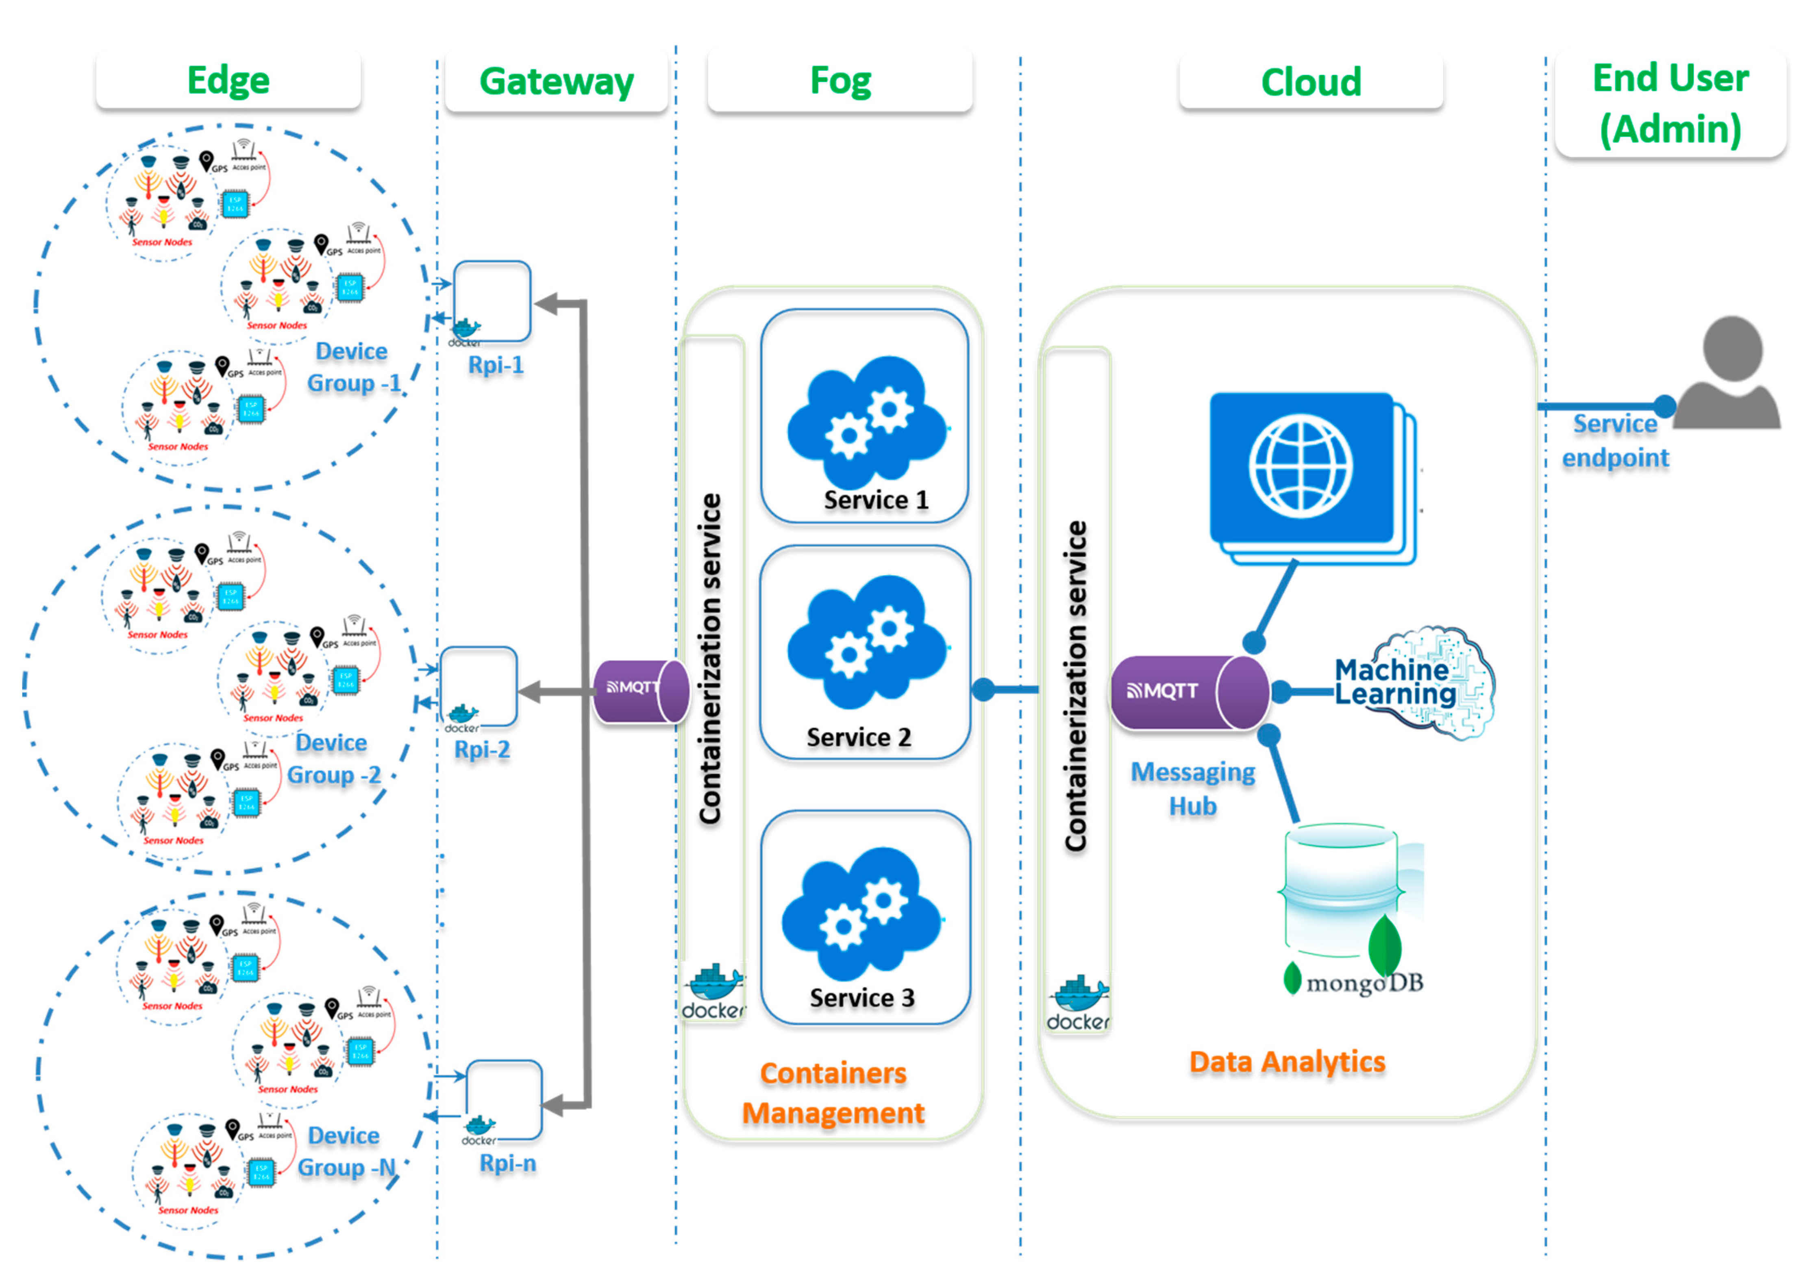
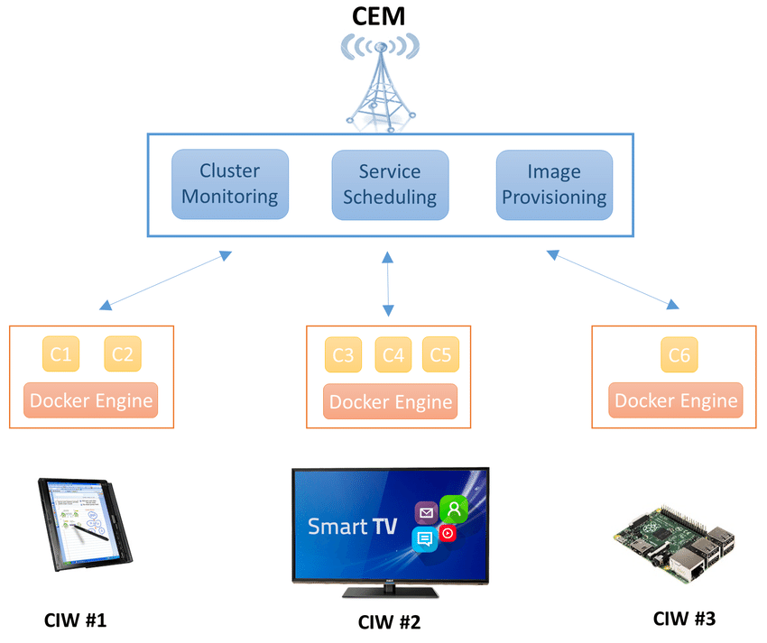
Ex1: >>
github simulation podman based IoT data sensor flow diagram, visualisasi
B. Sistem‑diagram kontainerisasi dengan Podman
Deskripsi komponen:
Edge layer: node sensor + ESP32 + lokal aggregator (misalnya gateway Raspberry Pi)
Container layer (di gateway atau server):
Container untuk MQTT broker (mosquitto)
Container untuk data ingestion service (misalnya Python Flask/Node.js)
Container untuk database (InfluxDB / PostgreSQL)
Container untuk visualisasi/dashboard (Grafana / ThingsBoard)
Cloud/Server layer: skalabilitas, remote access, backup, analytics
Penggunaan Podman: container runtime sebagai alternatif Docker, bisa deploy di server lokal.
Struktur Project GitHub
/iot‑hydroponic/
├─ /edge_gateway/
│ README.md
│ Dockerfile (atau Podman build file)
│ docker‑compose.yml (atau podman‑compose.yml)
│ /services/
│ mqtt_broker/
│ ingestion_service/
│ database/
│ dashboard/
├─ /sensor_node/
│ code_esp32/
│ main.ino
│ config.h
│ wiring_diagram.png
│
├─ /docs/
│ system_diagram.png
│ data_flow_diagram.png
│ deployment_guide.md
│
└─ README.md

Slide 9
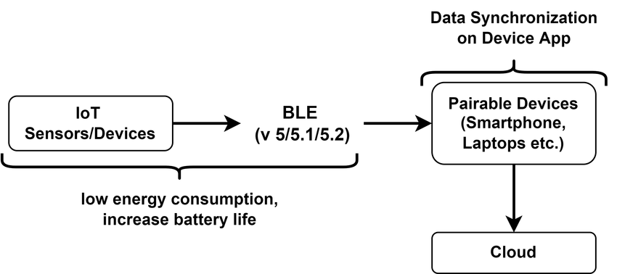
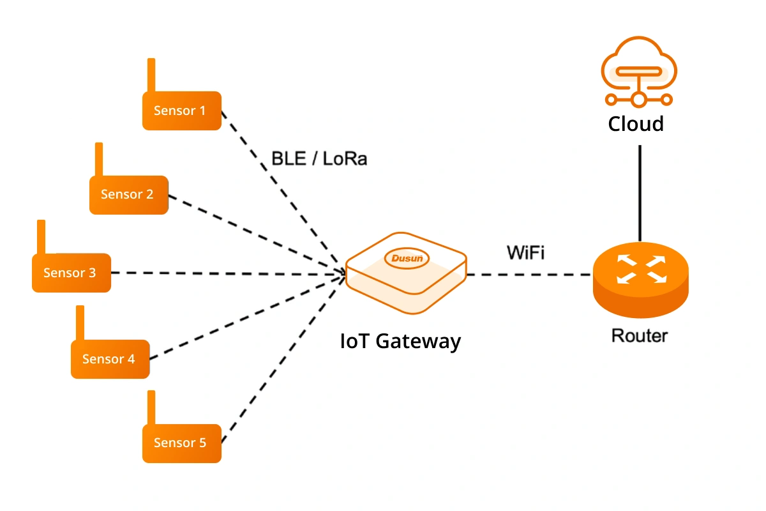
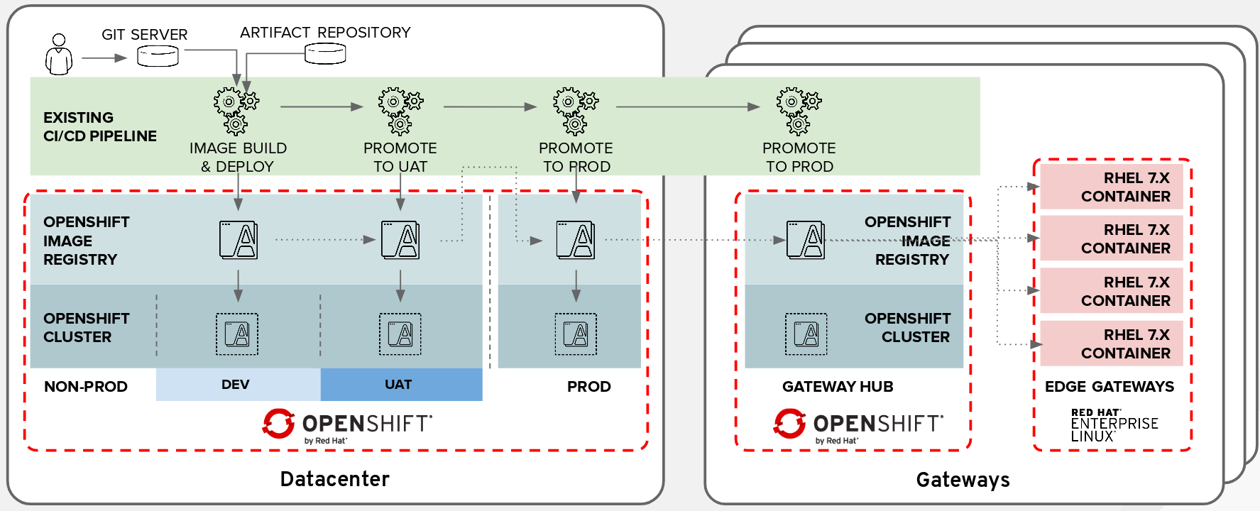
Ex1: >>
C. Monitoring
PlantMonitoringSystem (GitHub: Shishir3D/PlantMonitoringSystem) — sistem IoT monitoring tanaman (ESP32 + sensor kelembapan, suhu, kelembapan udara) yang punya dashboard mobile. GitHub
IOT‑Smart_Farming (GitHub: Deshan555/IOT‑Smart_Farming) — sistem pertanian pintar dengan berbagai sensor (cahaya, kelembapan, suhu, kelembapan udara) dan otomatisasi irigasi. GitHub
IOT‑MQTT‑Dashboard‑for‑ESP32‑Plant‑Sensor (GitHub: alialaei1/IOT‑MQTT‑Dashboard‑for‑ESP32‑Plant‑Sensor) — dashboard berbasis Django + MQTT + ESP32 untuk monitoring kondisi lingkungan tanaman. github.jpy.wang

Slide 10
Ex1: >>
Struktur Flow
Struktur Sistem dengan Podman
Sensor node (misalnya ESP32 + pH/EC/suhu/kelembapan) mengumpulkan data.
Data dikirim ke gateway/edge (misalnya Raspberry Pi atau mini‑server) via WiFi/MQTT/HTTP.
Di gateway: dijalankan layanan kontainer (menggunakan Podman) seperti broker MQTT, ingestion service (Python/NodeJS), database (InfluxDB atau PostgreSQL), dan dashboard (Grafana/ThingsBoard).
Dashboard menampilkan visualisasi realtime + historis, pengguna bisa mengontrol aktuator (pompa nutrisi, lampu LED grow, fan) dari situ.
(Opsional) Data juga dikirim ke cloud untuk backup/analitik lanjutan.
Setiap komponen dijalankan sebagai container:mqtt‑broker containerdata‑ingestor containerdatabase containerdashboard container
Podman menjalankan container (bisa rootless) dan/atau pods sehingga mudah deploy di server lokal atau edge gateway.
Struktur folder repository bisa seperti:
/edge_gateway/
podman-compose.yml Dockerfile‑ingestor configs/
/sensor_node/
firmware_esp32/
/docs/
system_diagram.png data_flow_diagram.png
README menjelaskan komponen, cara build & deploy dengan Podman, wiring diagram sensor.

Slide 11
Ex2: >>
IoT-data-simulator
https://github.com/IBA-Group-IT/IoT-data-simulator?tab=readme-ov-file
Simulator features that you will like:
Replay existing datasets with modified data (such as updated timestamps, generated ids etc);
Automatic derivation of dataset structure which allows you to customize your dataset without the need to describe its structure from scratch;
Generate datasets of any complexity. Generated data can be described via constructor or JavaScript function. Multiple rules are available in constructor such as "Random integer", "UUID" and others. JS function gives you maximum flexibility to generate data - it supports popular JS libraries lodash and momentjs.
Send data to the platforms you use with minimum configuration (see Supported target systems section);
Customize frequency with which data will be sent - based on dataset timestamp properties or just constant time interval. The tool also supports relative timestamp properties which depend on other timestamp or date properties. It means that data can be replayed with the same interval between timestamps as in initial dataset.
Easy installation - all you need is to download 2 docker files and run 2 commands.
branding

Slide 12
Ex3: >>
IoT-Podman-simulator
https://github.com/jdbranham/grafana-diagram
https://github.com/MarkhamLee/internet-and-iot-data-platform
https://github.com/aws-solutions/iot-device-simulator
https://github.com/KrishArul26/IoT-Based-Remote-Sensor-Data-Monitoring-and-Actuator-Control
https://blog.devops.dev/how-i-built-a-smart-home-monitoring-system-with-mqtt-go-prometheus-and-grafana-1fd91521baf8
https://github.com/Nilhcem/home-monitoring-grafana
IoT data monitoring with MQTT, InfluxDB and Grafana
https://github.com/jdbranham/grafana-diagram
https://github.com/iothon/docker-compose-mqtt-influxdb-grafana
https://mpolinowski.github.io/docs/DevOps/Provisioning/2019-01-08--creating-a-grafana-dashboard/2019-01-08/
https://github.com/TouradBaba/sensors_data_streaming

Slide 13
Thank you!
PDS
Computer Vision
Thank you For being a great class!
https://github.com/siagianp
https://www.youtube.com/@AmelOline/videos
https://github.com/amelcharolinesgn2/IoT_simulator-mqtt-NodeRed
https://github.com/amelcharolinesgn2/Cloud-Infrastructures
https://github.com/amelcharolinesgn2/ClouD-Infrastructure-SISKA-2025

